Slide 1

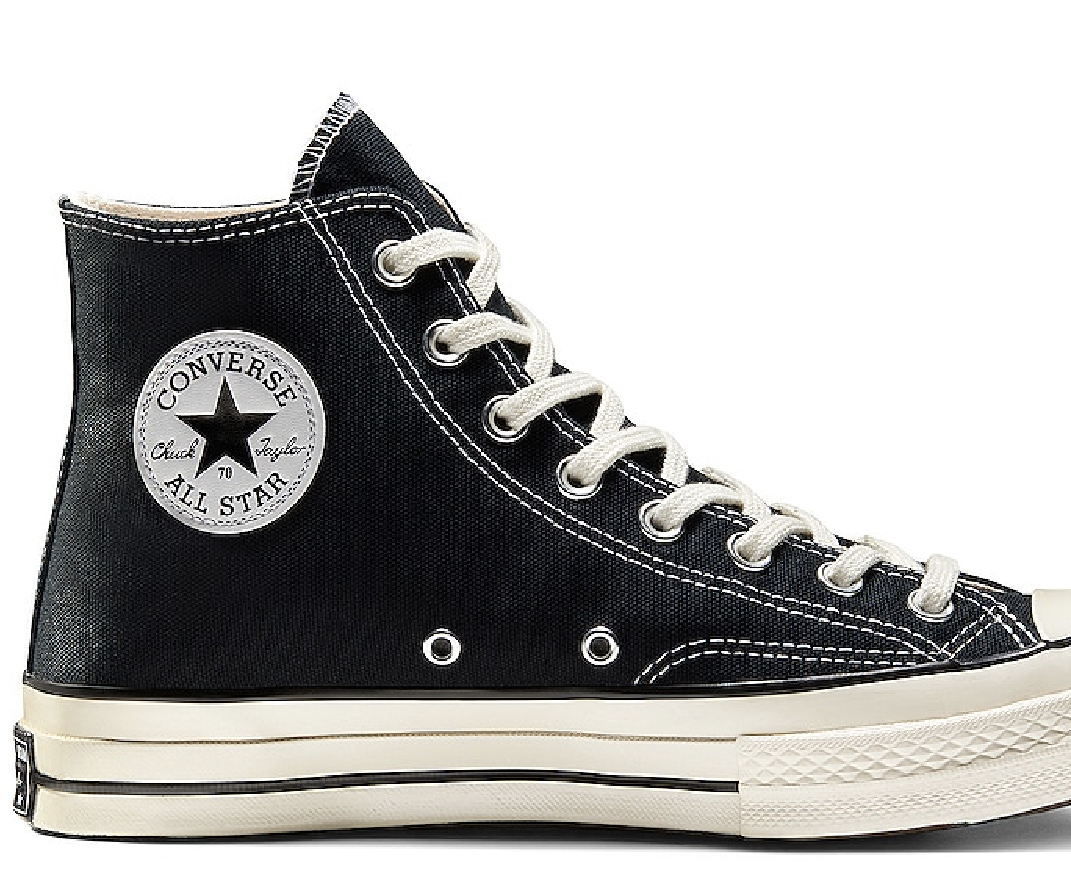

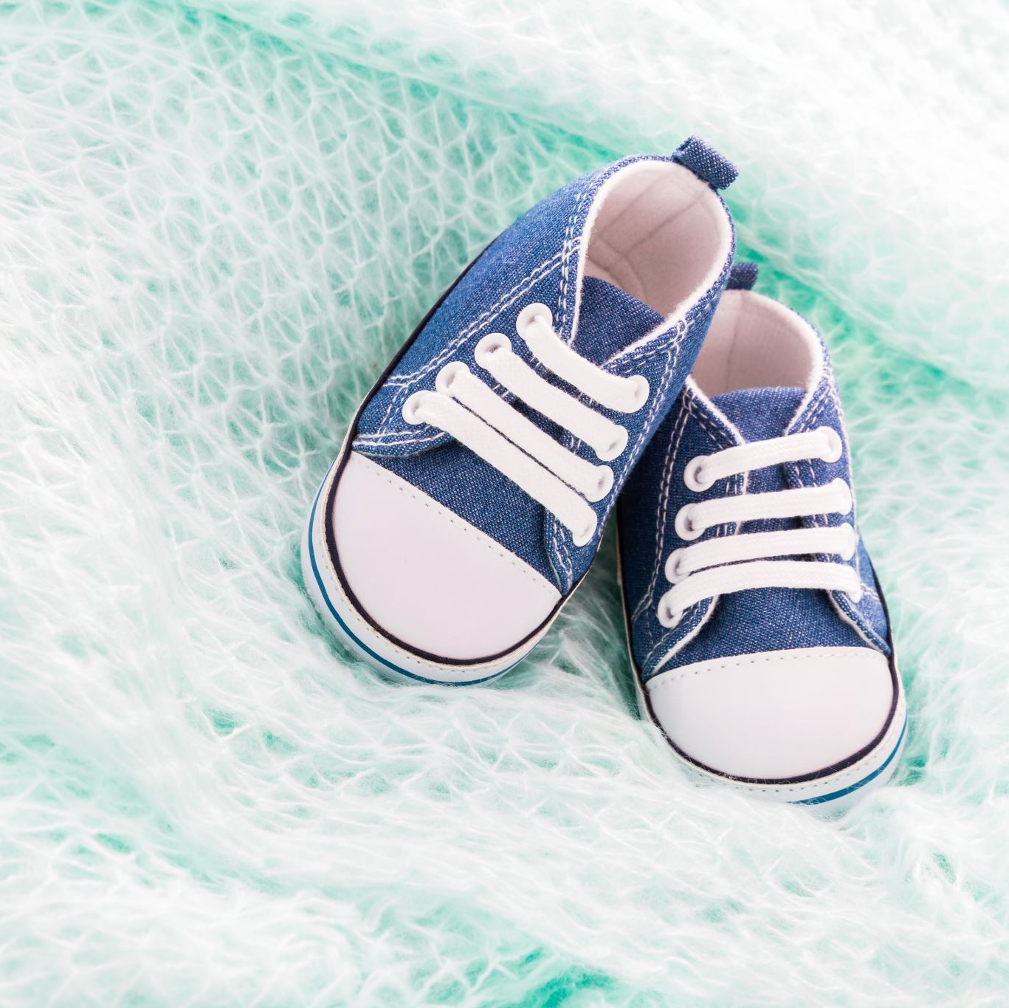
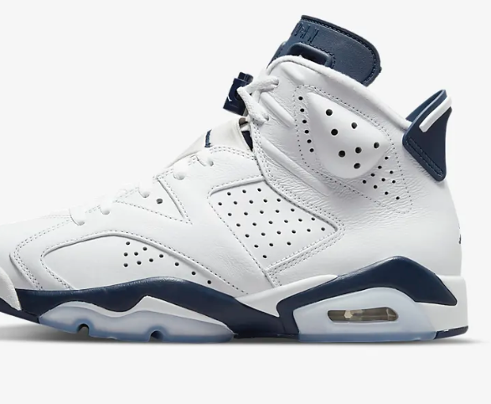
.sneakers
Made by :
Tanay Daga
(219301390)

Slide 2
BASIC IDEA
.sneakers is an ecommerce website where a user can visit the website online and can shop for the shoes he/she is willing to purchase.
Till date many websites are up on the internet which sell footwear for example -VEG NONVEG, AMAZON etc., but we here at .sneakers offers you the best price online
Here a user can subscribe to our newsletters where they can get to know which new article is coming in the market when the sale is going to get start.

Slide 3

Target audience
Students
Teenagers
People with age like 10-30 yrs.

Slide 4

Basic REQUIREMENTS
HTML5
CSS
JAVASCSRIPT

Slide 5
LEARNING MATERIALS
www.Youtube.com
www.coursera.org
www.Tabnine.com
Some books

Slide 6
FUNCTIONS
Customer can view/search products without login
Here customer can choose the size of the shoes which he is willing to buy
There is a checkout page where he/she needs to add their details like name, phone no., address details.
The user can also choose which color he/she wants to buy

Slide 7
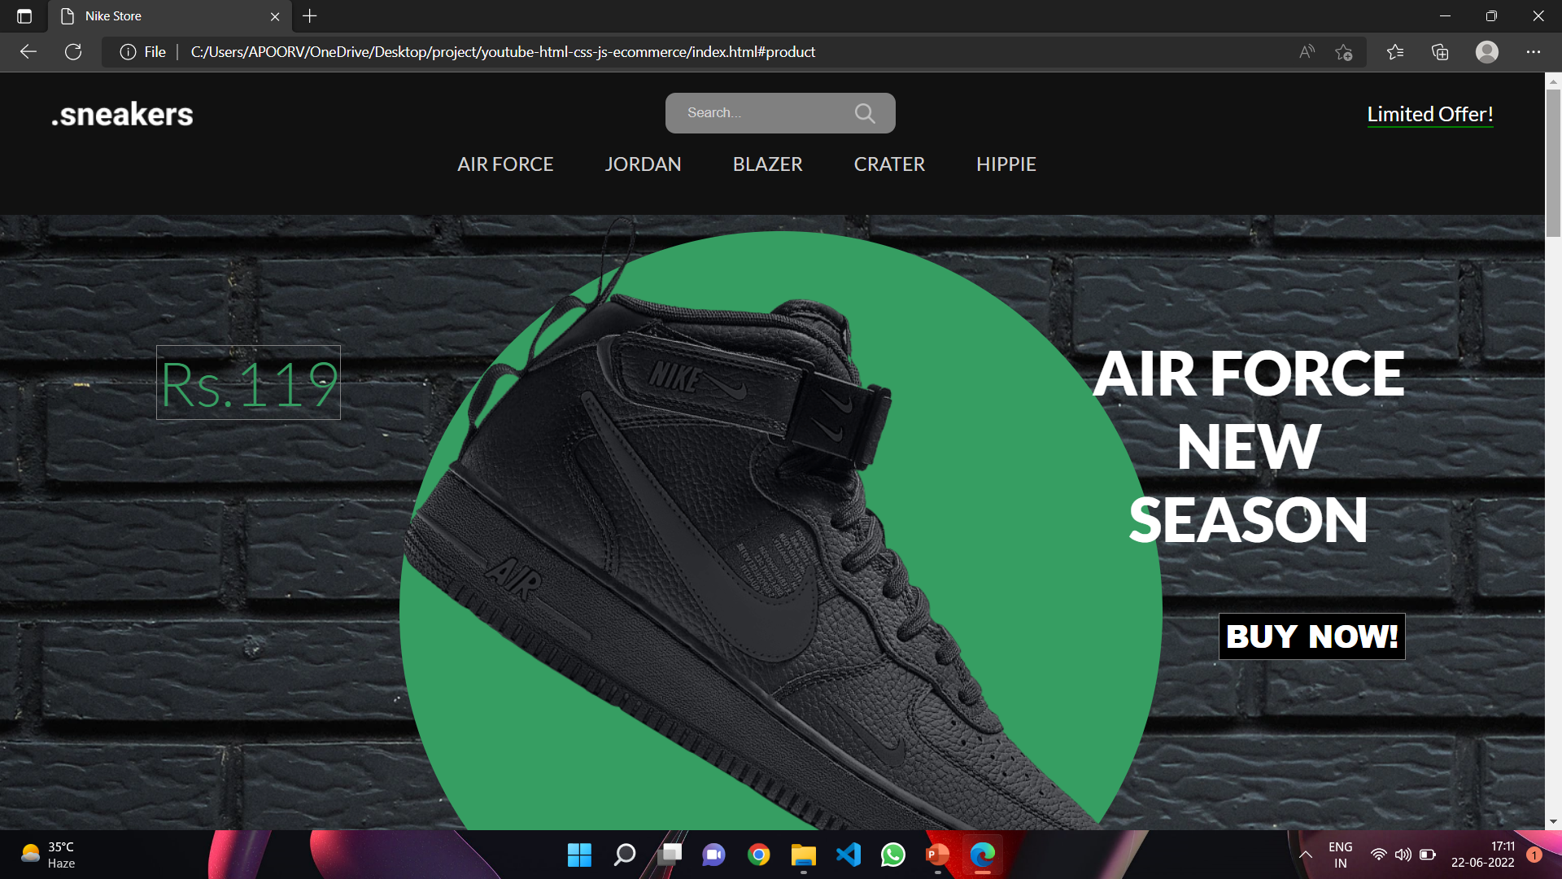
Home page

